Slide 1
Introduction to
Programming

Slide 2
Installing Anaconda

Slide 3
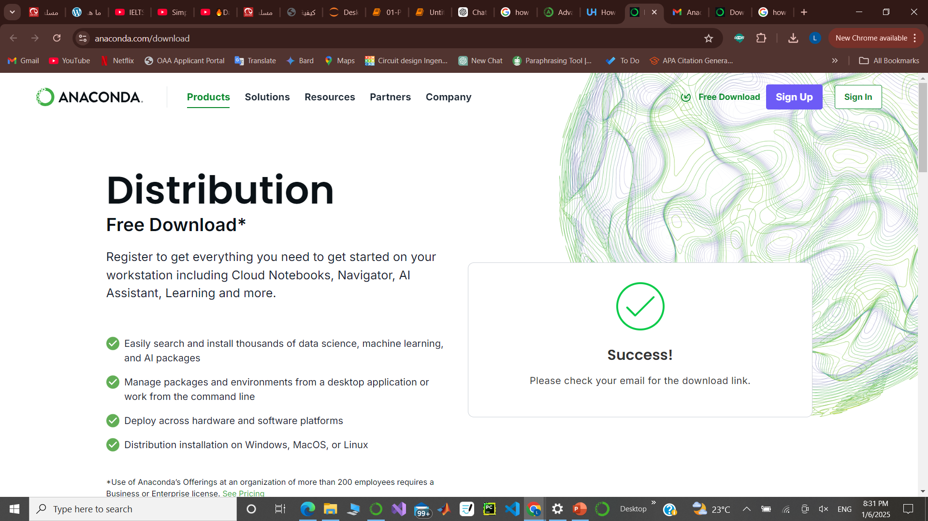
Step 1: Access the Anaconda Website
Open a web browser and navigate to the official Anaconda website

Slide 4
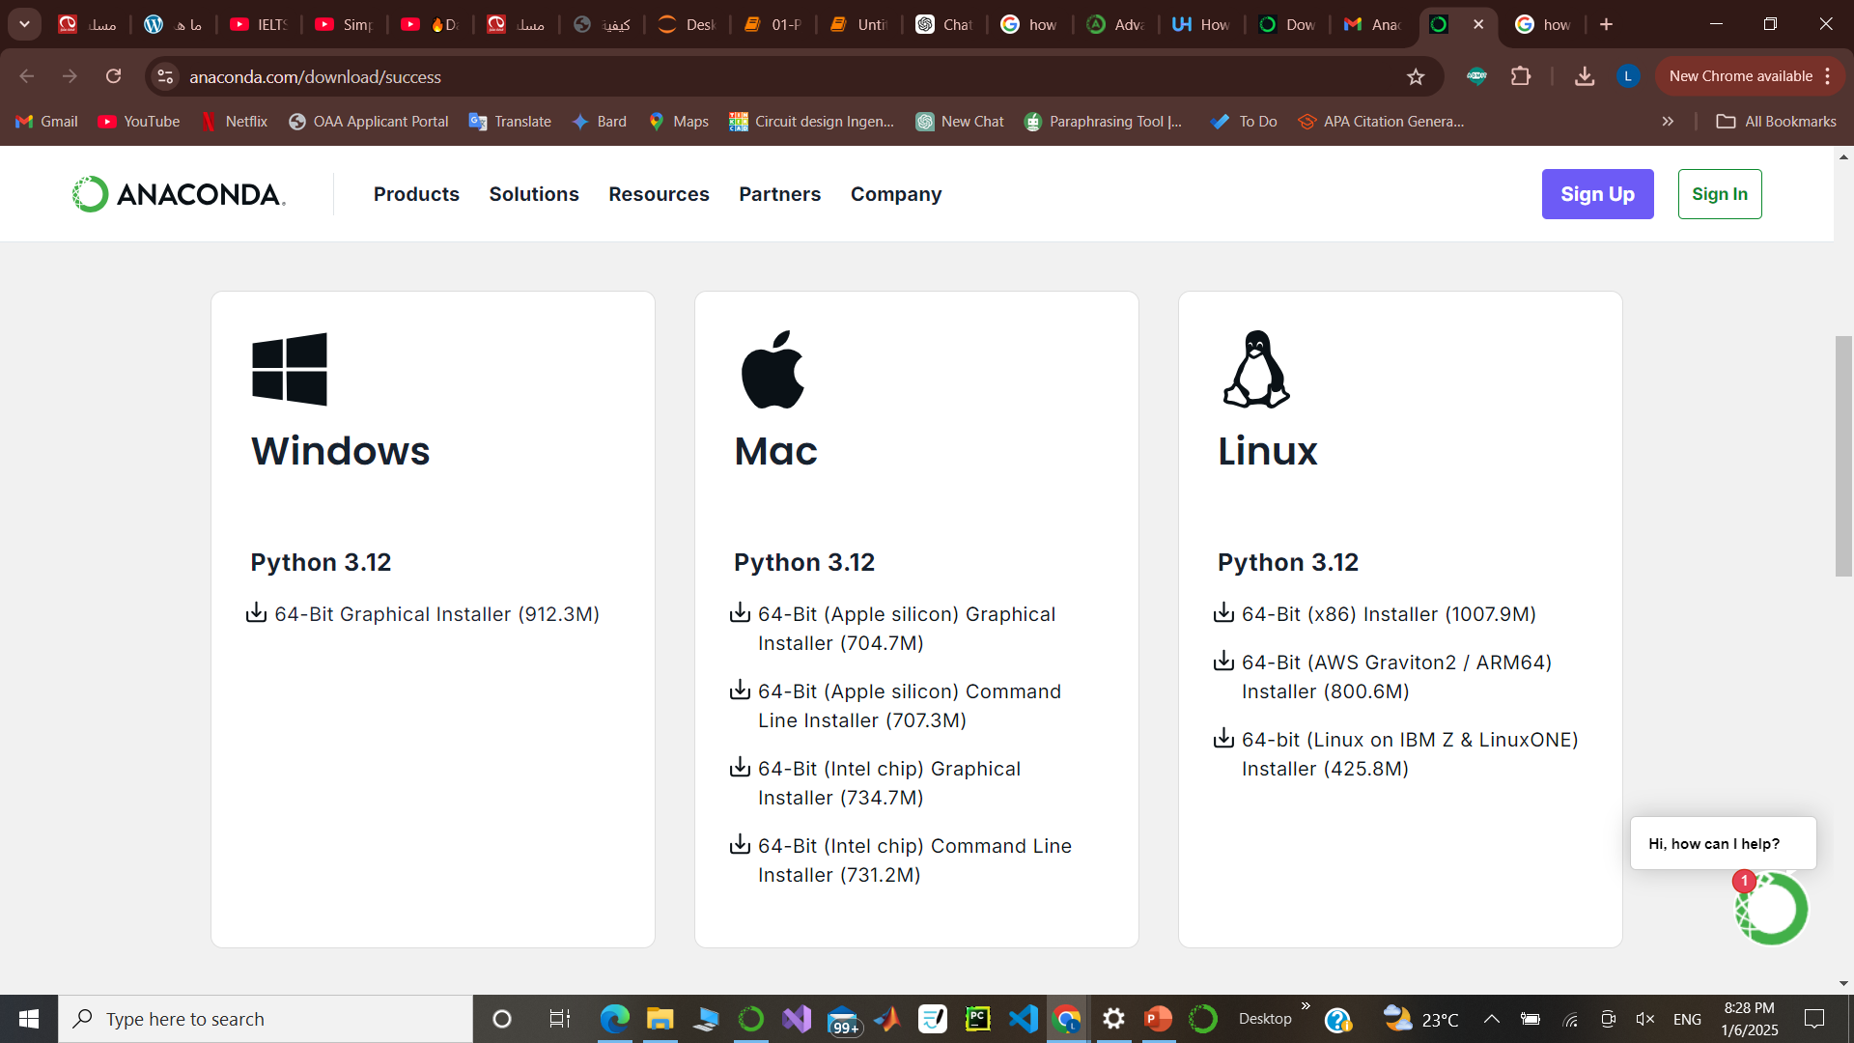
Step 2: Select the Windows Installer

Slide 5
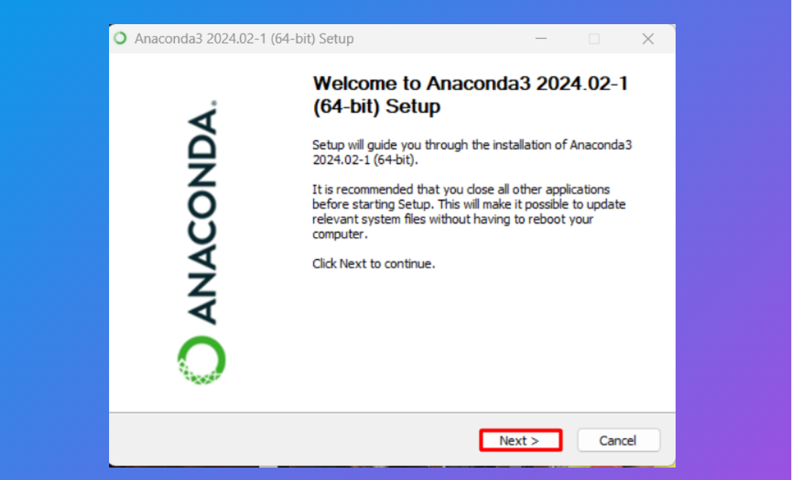
Step 3: Launching Anaconda Executable File

Slide 6
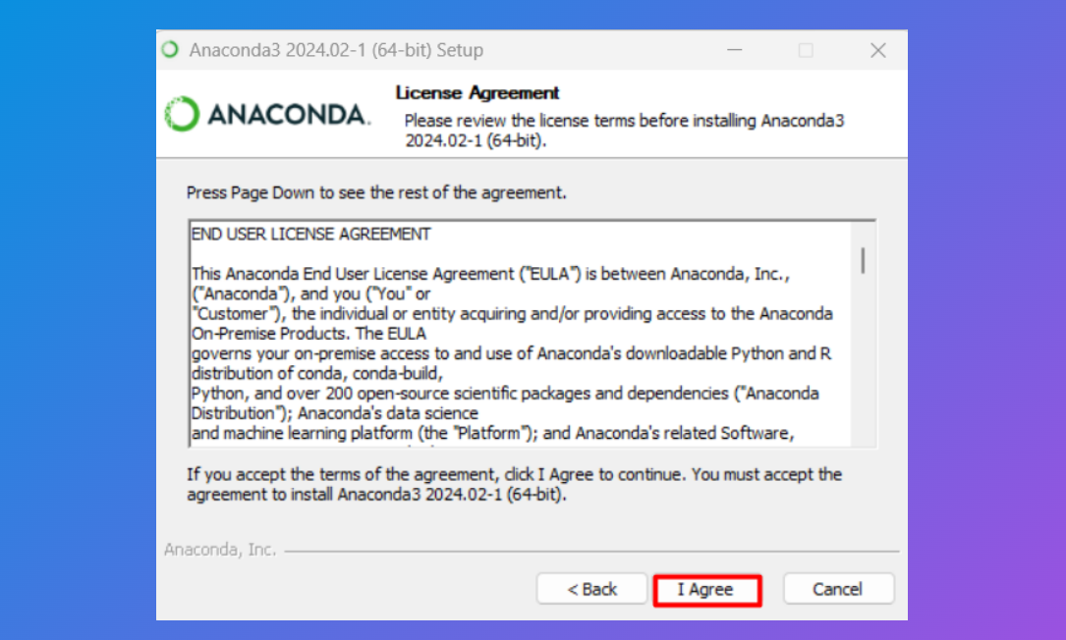
Step 4: Accept License Agreement

Slide 7
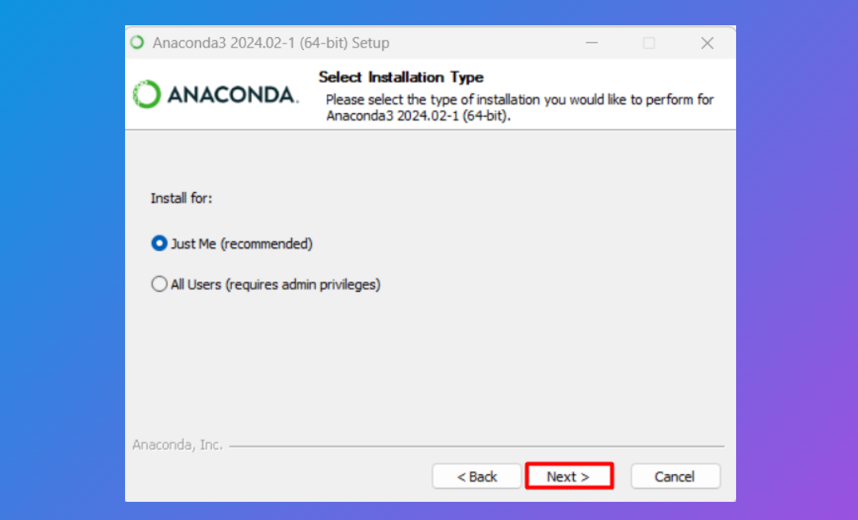
Step 5: Select Installation Type

Slide 8
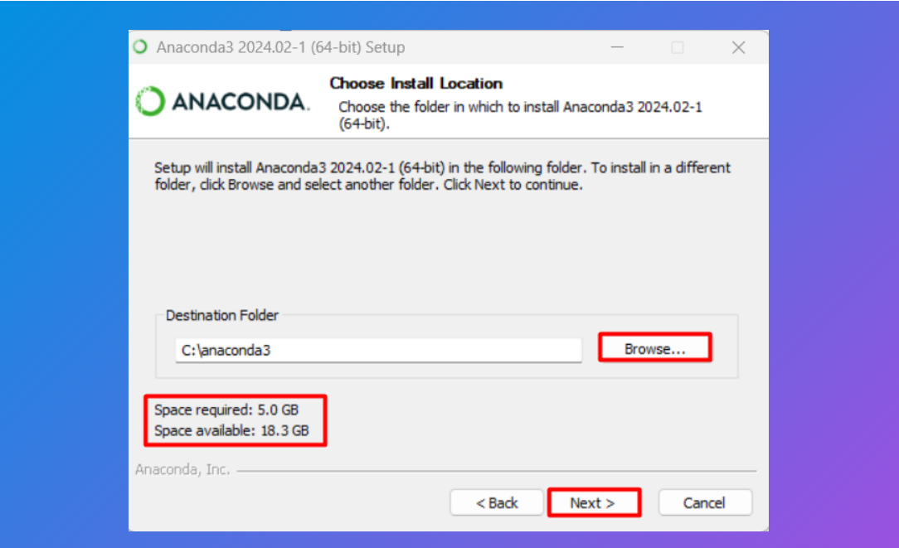
Step 6: Choose Installation Location

Slide 9
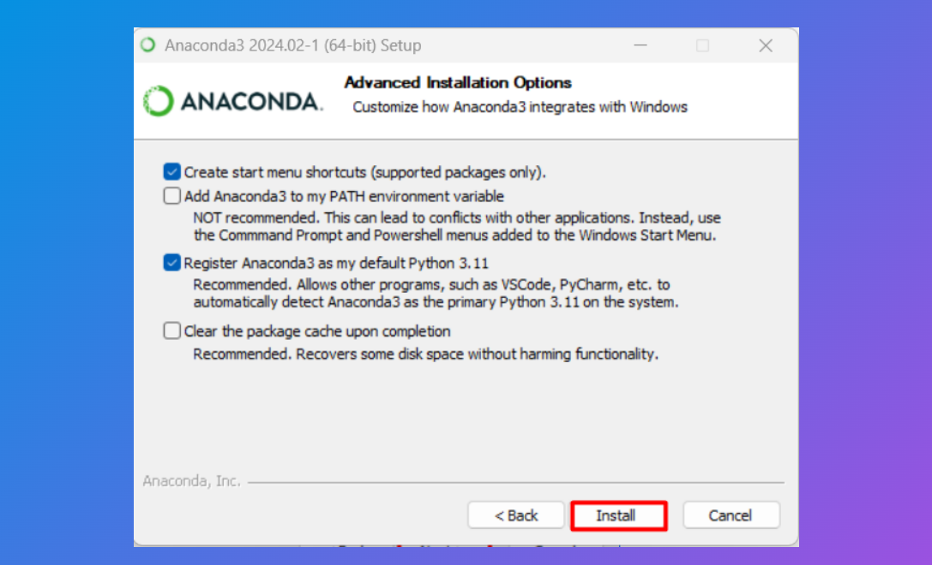
Step 7: Choose Advanced Installation Options

Slide 10
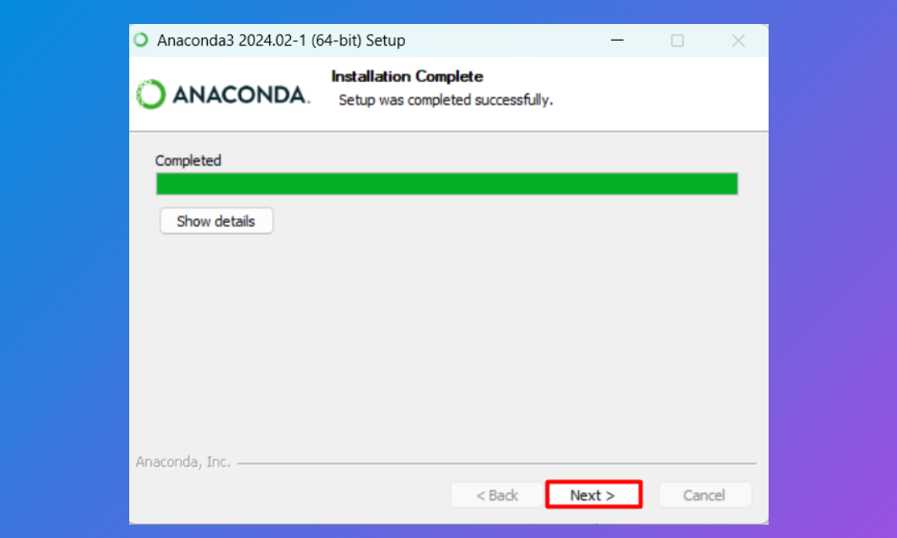
Step 8: After installation is complete, a new screen will appear with a prompt that installation completed:

Slide 11
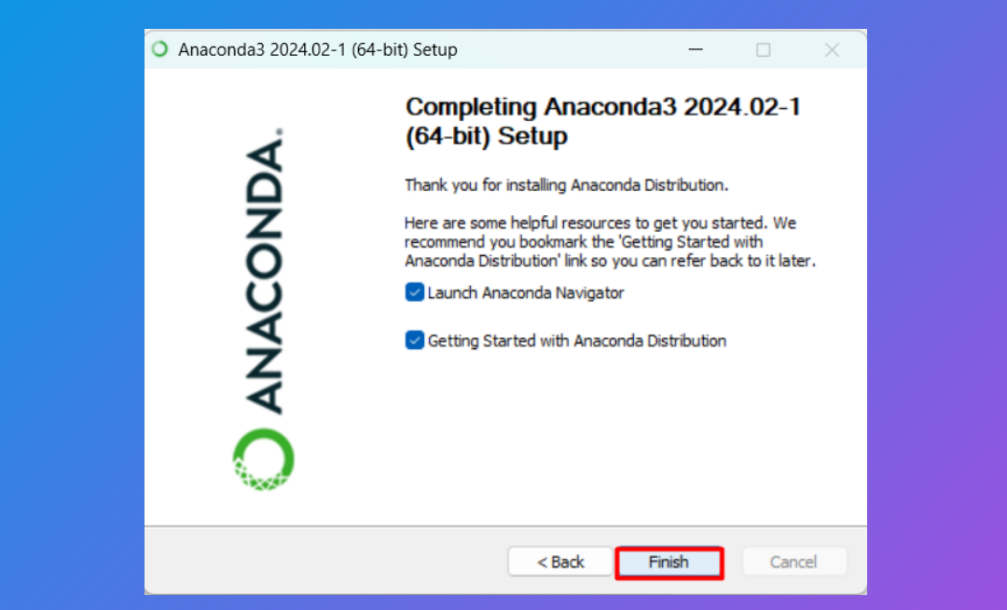
Step 9: Lastly, you can either launch anaconda navigator directly or just finish the installation:

Slide 12
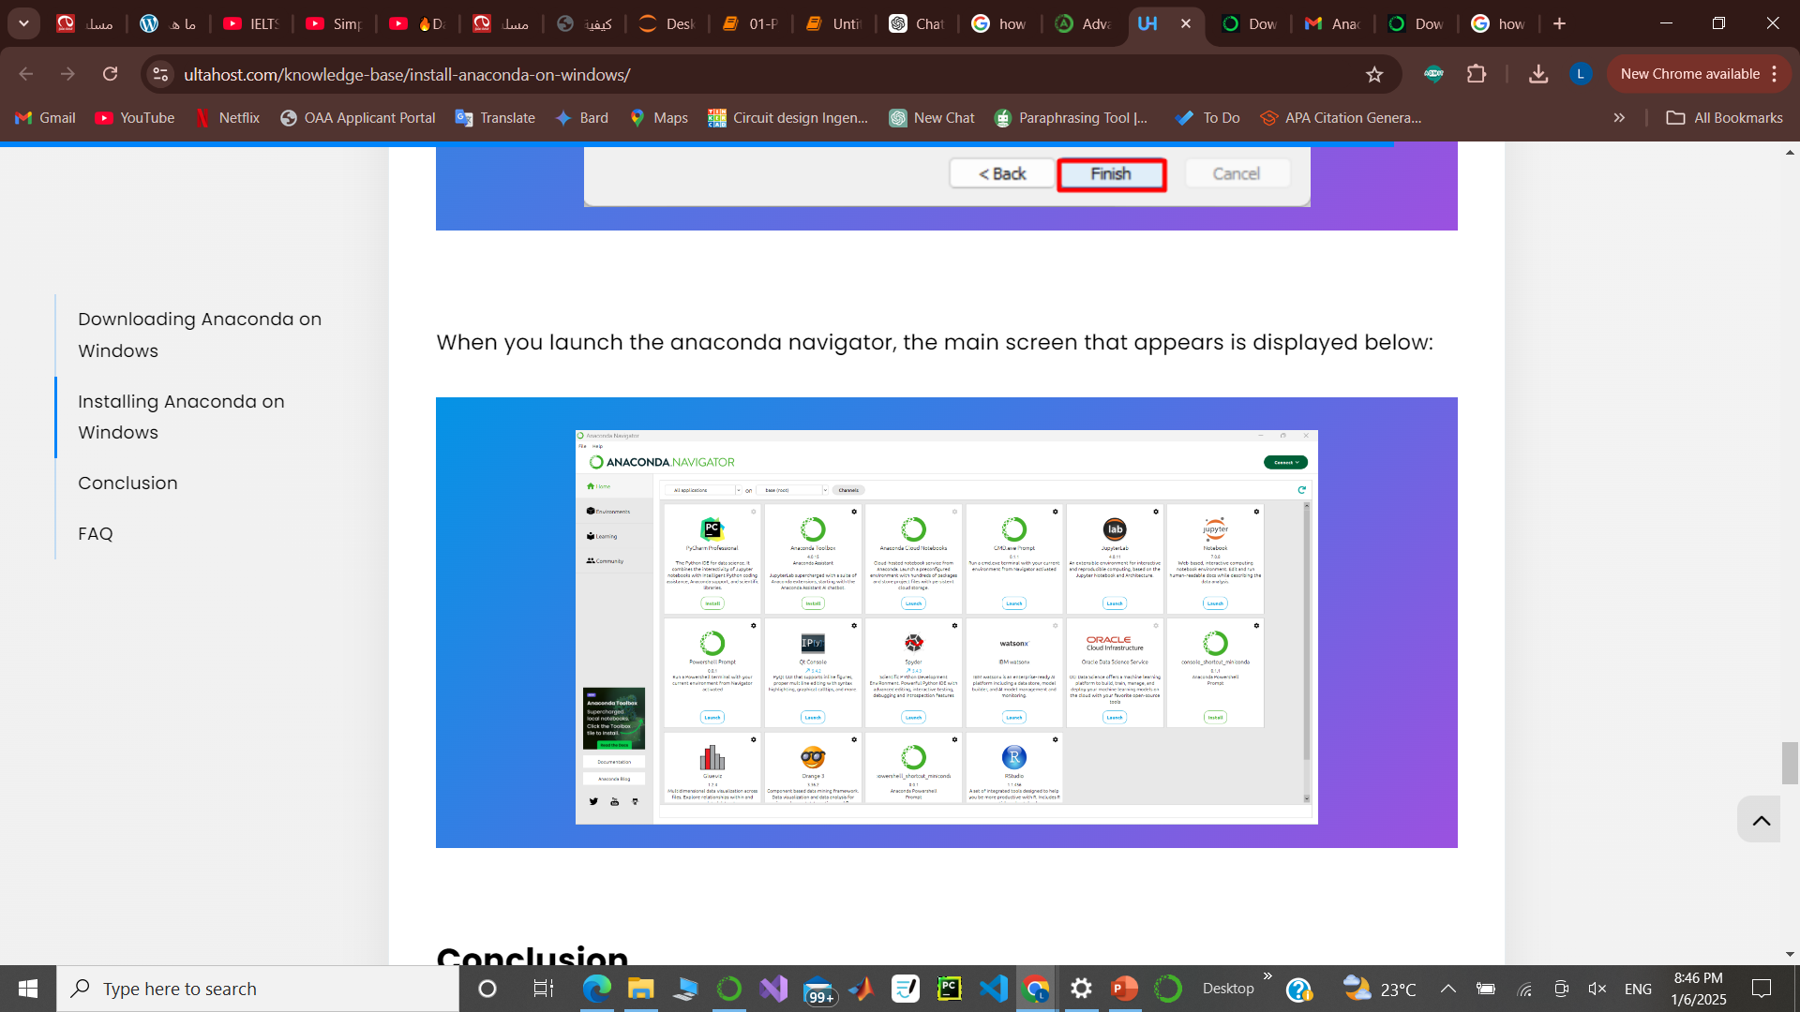
Step 10: launch anaconda navigator

Slide 13
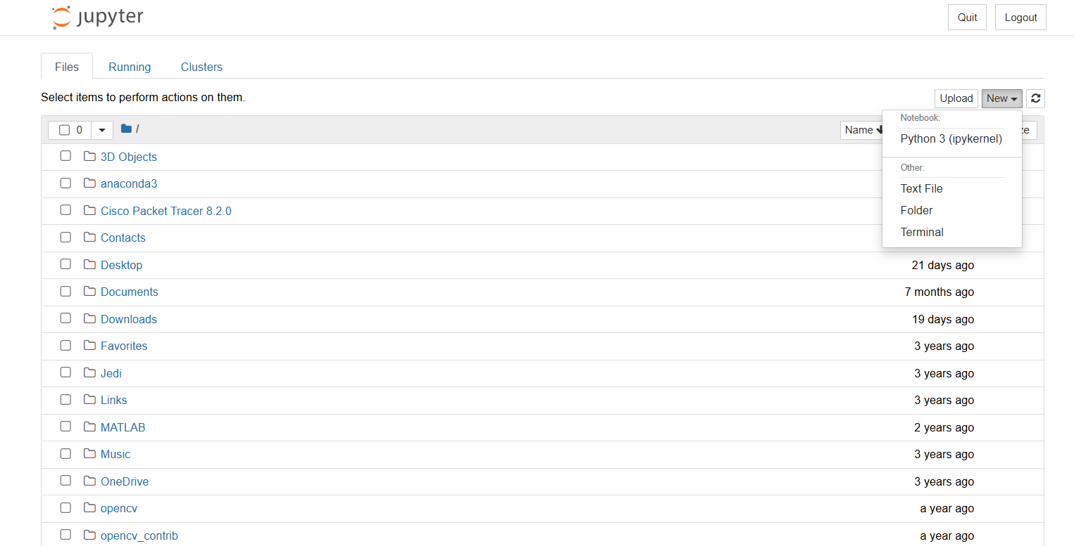
Step 11: Create your First Python Program

Slide 14
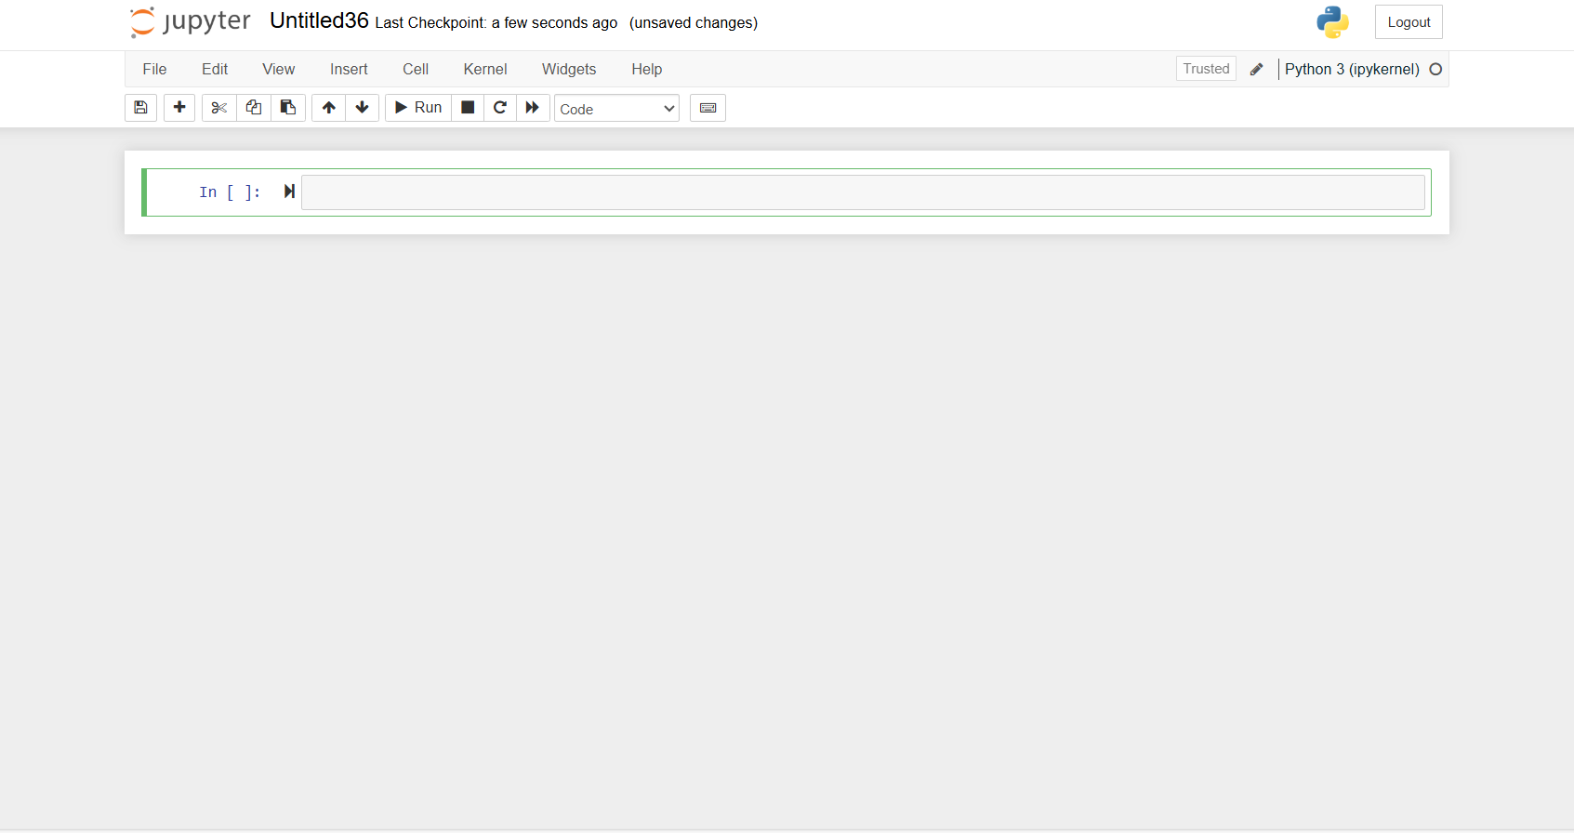

Slide 15
Sequences
Introduction to programming
Control Flow Tools
Data Structure
First
Next
Next
Next
Next
Last
Python function
Classes
Scope

Slide 16
Introduction to
Programming

Slide 17
Table of contents
01
02
03
Logical
Operators
Data Types
String

Slide 18

01
Data Types

Slide 19
Introduction to Data Types
Numbers
Boolean
Strings
Integer: 1 , 2 , 3 , 4 , etc..
Float: 1.1 , 2.2 , 3.3 , 4.4 , etc..
Complex: 1+6j , 6+3J
True -> 1
False -> 0
“AI Department JODDB”
‘Artificial Intelligence’

Slide 20
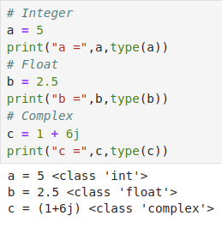
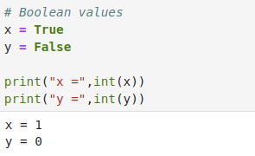
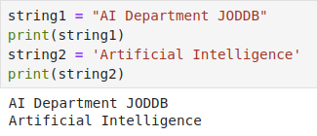
Examples
Numbers
Boolean
Strings

Slide 21
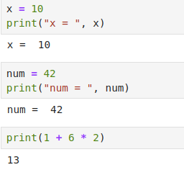
Expressions
Expressions form:
Examples:
Identifier: Any name that refers to a class, function, or variable (X, Y).
Literals: Way of writing a value (1, 2, 9).
Operators: Tokens that represent certain operations (+, -, *).

Slide 22
02
Logical Operators

Slide 23
Operators
Python divides the operators into the following groups:
Arithmetic operators (+, -, *, /, %, **, //)
Assignment operators (=, +=, -=, *=, /=, %=, //=, **=, &=)
Comparison operators (==, !=, >, <, >=, <=)
Logical operators (and, or, not)
Identity operators (is, is not)
Membership operators (in, not in)

Slide 24
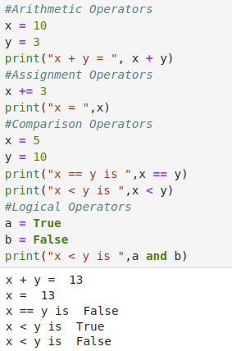
Examples

Slide 25
03
Strings

Slide 26
Introduction to String
Creating Strings : strings can be created in Python using either single quotes or double
quotes

Slide 27
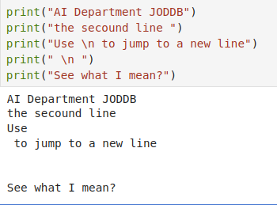
Introduction to String
Print Srting: using a print statement.

Slide 28
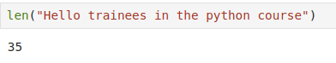
Introduction to String
String length: To get the length of a string, use the built-in function len().

Slide 29
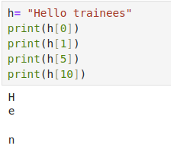
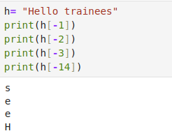
Access String characters
• String Indexing
• Negative Indexing

Slide 30
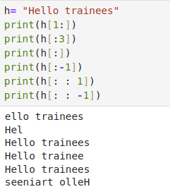
Access String characters
Range of Indexes:You can specify a range of indexes by specifying the start and end
points.

Slide 31
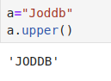
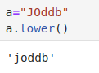
Basic Built-in String methods
Upper Case:The upper() method returns the string in upper case.
Lower Case:The lower() method returns the string in lower case.

Slide 32
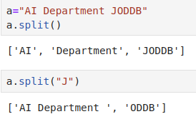
Basic Built-in String methods
Split String:The split() method splits the string into substrings if it finds instances of the
separator.

Slide 33
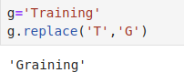
Basic Built-in String methods
Replace String:The replace() method replaces a string with another string.

Slide 34
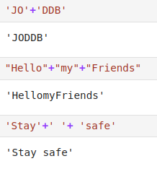
Strings Concatenation
• To concatenate, or combine, two strings you can use the (+) operator

Slide 35
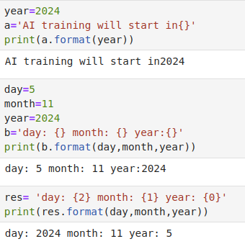
Strings Format
• Use the format() method to insert numbers into strings.

Slide 36
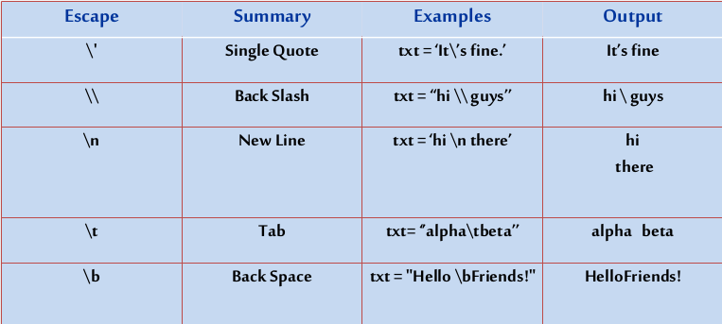
Strings Escape Characters

Slide 37
Control Flow Tools

Slide 38
Table of contents
01
02
03
04
Loop Statements
Break, Continue
& Pass
Statements
If Statements
Range Function

Slide 39
01
If Statements

Slide 40
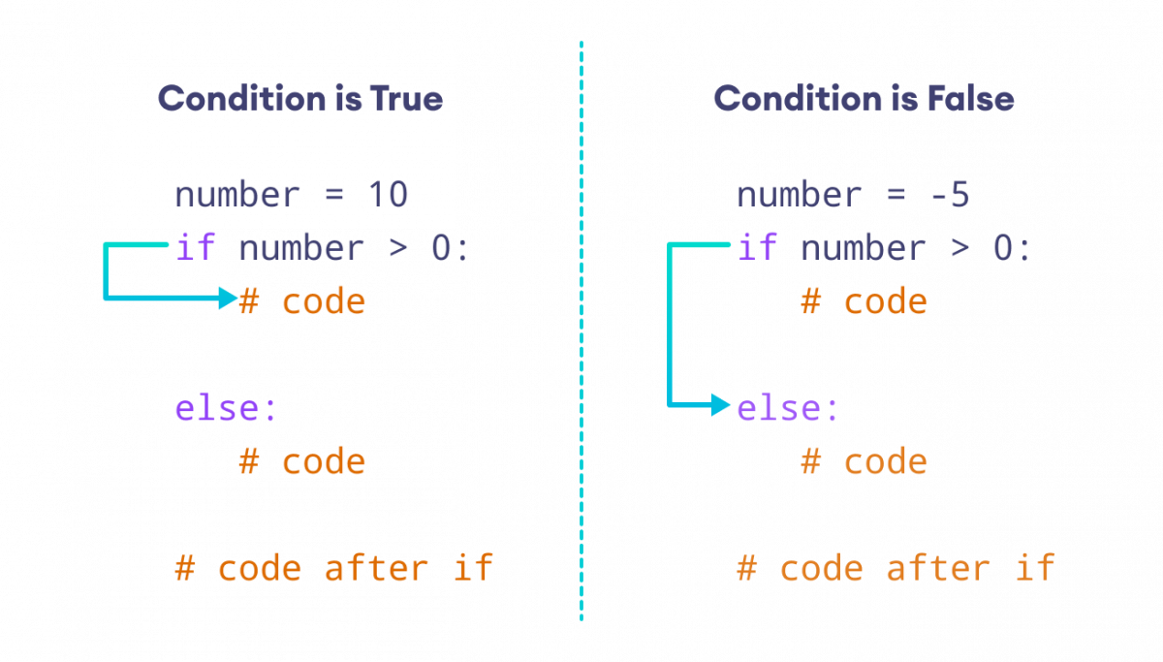
What is Python If Statement?
Python if Statement: is used to make a decision. It contains a block of code in the body which will run only if the condition is true. If the condition is false then else statement will be executed.
Python if Statement Syntax:

Slide 41
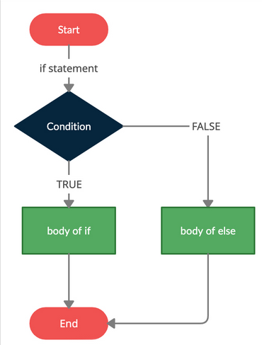
If Statement Flowchart
Python if…else Flowchart:

Slide 42
Logical Conditions
• Python supports of using the logical conditions:
Equals: a == b
Not Equals: a != b
Less than: a < b
Less than or equal to: a <= b
Greater than: a > b
Greater than or equal to: a >= b

Slide 43
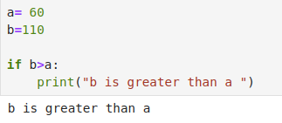
Logical Conditions
The logical conditions are most commonly used in If Statements and Loops Statements.

Slide 44
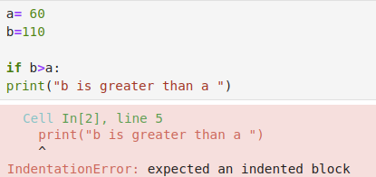
Indentation
Python uses an indentation as definition of the scope in the code. It is a whitespace at the beginning of each line of codes.

Slide 45
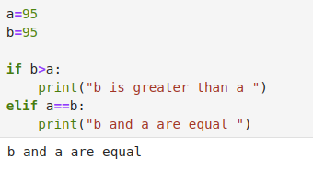
Elif
The elif keyword is used in python to tell if the previous conditions were not true, then try this
condition.

Slide 46
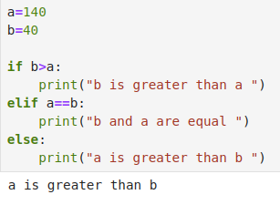
Else
The else keyword is executed if all previous conditions were not true.

Slide 47
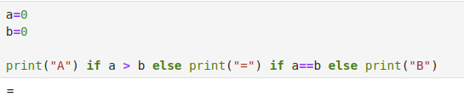
Shorthand If … Else
You can have multiple else statements on the same line of code.

Slide 48
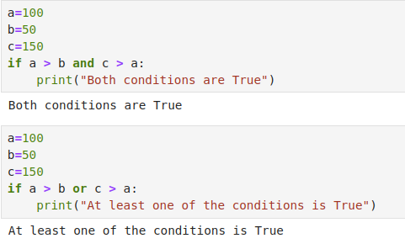
And & Or keywords
The and & or keywords are logical operators, used to combine conditional statements.

Slide 49
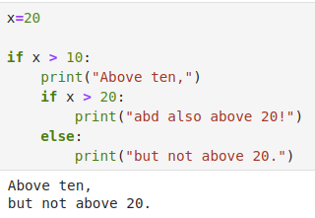
Nested If
Nested if: You can have if statements inside if statements.

Slide 50
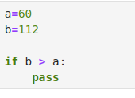
Pass Statement
If statements can not be empty, if we have an empty if statement we can put the pass statement
to prevent any errors

Slide 51
02
Loop Statements

Slide 52
What is Loop?
Loop: can execute a block of code by number of times until the end of condition. Python has just two direct loops commands (while, for loops).
For Loop: is used to iterate over elements or items. It is used when you have a block of code which you want to repeat over number of time.
While Loop: is used when you want to repeat a lines of codes. Instead of executing the block of code once, it executes the block multiple times until the end of condition.

Slide 53
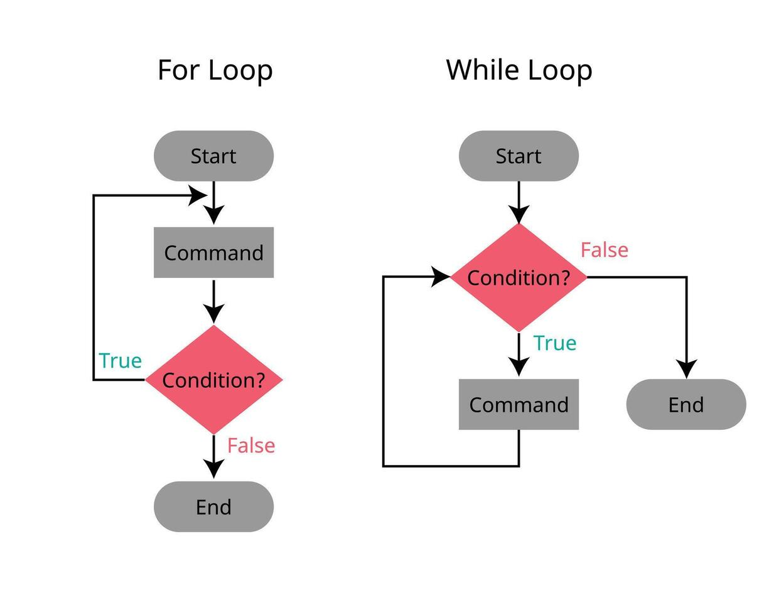
For & while loops Flowchart

Slide 54
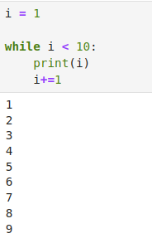
The while loop
While loop can execute a number of statements while the condition is true.

Slide 55
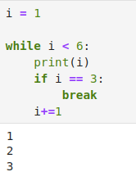
The break statement
Break statement can stop the while loop even if the loop condition is true.

Slide 56
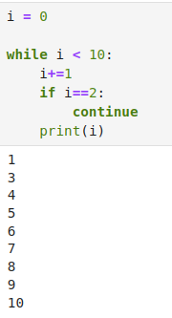
The continue statement
Continue statement can stop the current iteration and continue to the next.

Slide 57
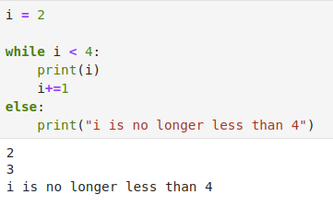
The else statement in while loop
else statement in while loop can run block of code once the condition is no longer is true.

Slide 58
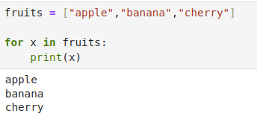
The for loop
For loop is used for iterating over a sequence (list, tuple, dictionary, set, and string).

Slide 59
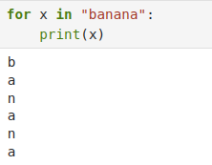
Looping Through a String
Strings are inerrable objects, so we can iterate on this sequence of characters.

Slide 60
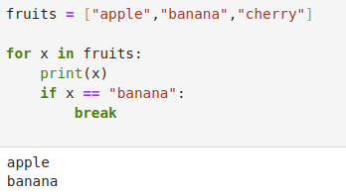
The break Statement
We can stop the loop before looping through all the elements.

Slide 61
03
Range Function

Slide 62
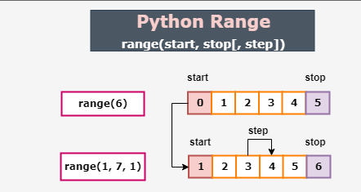
The range Function
Range function is used too loop through a block of codes with a specified number of times.

Slide 63
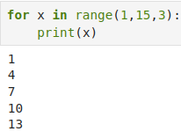
The range Function
Range function default increment by 1, we can specify the increment by changing the third parameter.

Slide 64
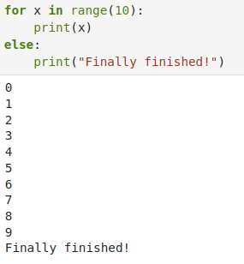
Else in For loop
Else keyword in for loop specifies a block of codes to be executed when the loop is done.

Slide 65

Nested Loops
The inner loop will be executed one time for each iteration of the outer loop.

Slide 66
Data Structure

Slide 67
Main topic
Tuple
List
Set
Dictionary

Slide 68
01
List

Slide 69
Introduction to Lists
Lists are Python’s most flexible ordered collection object type. Unlike strings, lists can contain any sort of object: numbers, strings, and even other lists.
Lists are created using square brackets
List =[item 1 , item 2 , item 3 ,…]

Slide 70
Introduction to Lists
Lists: are used to store multiple items in a single variable (mutable).
List Items: ordered, changeable, and allow duplicate values.

Slide 71

Introduction to Lists
List Length: To determine how many items a list has, use the len() function.

Slide 72

Introduction to Lists
List Data Types: items can be of any data type, and a list can contain different data types

Slide 73

Access List items
Index number: List items are indexed, the first item in the list has the index [0], the second item has index [1]
List items can be accessed by referring to the index number

Slide 74

Access List items
Negative Indexing: means start from the end

Slide 75


Access List items
Range of Indexes: You can specify a range of indexes by specifying the start and end points
Check if an Item Exists or not in the list

Slide 76

Access List items

Slide 77

Access List items

Slide 78


Change List items
Change Item Value
Change a Range of Item Values

Slide 79

Change List items
Insert Items

Slide 80


Add List items
Append Items
Extend List

Slide 81


Remove List items
Remove Specific Item
Remove Specified Index using pop

Slide 82


Remove List items
Remove Specified Index using del
Remove Specified Index using clear

Slide 83


Loop inside Lists
Loop in the list
Loop Through the Index Numbers

Slide 84


Loop inside Lists
Using a While Loop
Looping Using List Comprehension

Slide 85


List Comprehension
List comprehension: allows the creation of a new list based on the values of an existing list using shorter syntax.
Syntax of list comprehension:
List_syn : [expression for item in iterable if condition == True]

Slide 86


Sort Lists
Alphabetically
Reverse

Slide 87


Copy Lists
There are many ways to make a copy of the list, one way is to use the built-in List method copy()
Making a copy of a list using the built_in list() method

Slide 88

List Methods

Slide 89
02
Tuples

Slide 90
Introduction to Tuples
Tuples: A tuple is a collection which is ordered and unchangeable (Immutable).
Allow Duplicates
Tuple Data Types

Slide 91


Access Tuple items
Access Tuple Items
Negative Indexing

Slide 92


Access Tuple items
Range of Indexes
Check if Item Exists

Slide 93


Update Tuples
Change Tuple Values
Add Items

Slide 94

Update Tuples
Remove Items

Slide 95


Loop inside Tuples
Loop Through a Tuple
Loop Through the Index Numbers

Slide 96

Loop inside Tuples
Using a While Loop

Slide 97


Join Tuples
Join Two Tuples
Multiply Tuples

Slide 98

Tuples Methods

Slide 99
03
Sets

Slide 100


Introduction to Tuples
Set: is a collection which is unordered and unindexed (immutable).
Duplicates not allowed
Set Data Types

Slide 101


Access Set Items
Access Items

Slide 102


Add Set Items
Add Items
Add Sets

Slide 103


Remove Set Items
Remove Item using remove
Remove Item using pop

Slide 104


Remove Set Items
Remove Item using clear
Remove Item using delete

Slide 105

Loop Sets

Slide 106

Join Sets
Join Two Sets

Slide 107

Join Sets
Select the Duplicates

Slide 108

Sets Methods

Slide 109
04
Dictionary

Slide 110


Introduction to Dictionaries
Dictionary: is a collection that is ordered, changeable, and does not allow duplicates (mutable).
Dictionary Items --> (key: value pairs)
Duplicates Not Allowed

Slide 111

Introduction to Dictionaries
Dictionary Data Types
Duplicates Not Allowed

Slide 112


Access Items
Access Items

Slide 113



Access Items
Get Keys:
Get Values:
Get Items:

Slide 114


Change Items
Change Values
Update Dictionary

Slide 115


Remove Items
Remove Items using pop
Remove Items using del

Slide 116

Remove Items
Remove Items using clear

Slide 117

Loop inside Dictionary
A dictionary can be looped through using the for loop.

Slide 118

Copy Dictionaries
There are many ways to make a copy of a dictionary, one way is to use the built-in method copy()

Slide 119

Nested Dictionaries
Nested Dictionaries: when the dictionary contains dictionaries

Slide 120

Dictionary Methods

Slide 121
Python Functions

Slide 122
Table of contents
01
02
03
04
Functions
Argument
Classes
Scope

Slide 123
01
Functions

Slide 124
Introduction to Function
▪ A function is a block of code, that only runs when it is called for execution.
▪ Those blocks can be reused to avoid repeating the same instructions.
▪ You can pass data known as parameters.
▪ A function can return data as an output.

Slide 125
Function Indentation
▪ Indentation is used in python to identify blocks of code.
▪ Code within the same block should be indented at the same level.
▪ Python function is one type of code block. All code under a function declaration should be indented to identify it as part of the function.
▪ There can be additional indentation within a function to handle other statements such as for and if so long as the lines are not indented less than the first line of the function code.

Slide 126


Creating Function
In Python a function is defined using the def keyword followed by the function name and the parenthesized parameters.
▪ Example:

Slide 127
Calling Function
Use the function name followed by parenthesis.
▪ Example:

Slide 128

Logic with Functions
we can perform logical statements (such as if/else/if statements, for and while loops, checking if an item is in a list or not in a list )within a function.
▪ Example:

Slide 129

Logic with Functions
▪ Example: function returns all the even numbers in a list.

Slide 130
02
Arguments

Slide 131
Introduction to Arguments
Information can be passed into functions as arguments.
Arguments are specified after the function name, within the parentheses of the function definition.
▪ Example:

Slide 132

Number of Arguments
Python functions can have multiple parameters.
Function must be called with the correct number of arguments. Meaning that if your function expects 2 arguments, you have to call the function with 2 arguments, not more, and not less.
▪ Example:

Slide 133

Keyword Arguments
You can send arguments with the key = value syntax.
▪ Example:

Slide 134

Special Arguments
*args and **kwargs can be passed into the same function, but *args have to appear before **kwargs

Slide 135

Interactions between Python
Functions
When using results from functions as input of another function.
The best example of Interactions between Python Functions is a guessing game
There will be 7 positions in the list, one of which is an 'O', a function will shuffle the list

Slide 136


Interactions between Python
Functions
Another function will take a player's guess
And the third one will check if the guess is correct according on the output of the two previous functions.

Slide 137

Interactions between Python
Functions
Now we create a little setup logic to run all the functions. Notice how they interact with each other

Slide 138

Arbitrary Arguments (*args)
If you do not know how many arguments that will be passed into your function, add a * before the parameter name in the function definition.
▪ Example:

Slide 139

Arbitrary Keyword Arguments
(**kwargs)
If you do not know how many keyword arguments will be passed into your function, add two asterisks: ** before the parameter name in the function definition.
▪ Example:

Slide 140

Default Parameter Value

Slide 141

Passing a dictionary as an Argument
Send any data type of argument to a function (string, number, list, dictionary), and it will be treated as the same data type inside the function.
▪ Example:

Slide 142

Return Values
Return () statement can be used to let a function return a value that can then be stored as a variable, or used in whatever manner a user wants.
▪ Example:

Slide 143
Lambda Expression
A lambda function is a small anonymous function that can be created with the lambda keyword.
A lambda function can take any number of arguments, but can only have one expression
syntactically restricted to a single expression
▪ Syntax
➢ lambda arguments : expression

Slide 144


Lambda Expression
Lambda functions can take any number of arguments:
▪ Example:

Slide 145

Lambda Expression
Lambda functions can take any number of arguments:
▪ Example:

Slide 146

Map and Filter Functions
map() function: built-in function returns the specified iterator with the results after applying the function to each item of a given iterable.
▪ Example:

Slide 147

Map and Filter Functions
Syntax: map(function, iterable)
items sent to the function as parameters
▪ Example:

Slide 148

Map and Filter Functions
You can pass one or more iterable to the map() function
▪ Example:

Slide 149
Map and Filter Functions
The filter(): Use a filter function to exclude each element in the iterable object to be true or not.
Syntax: filter(function, iterable)
function: a function that tests if each element of a iterable is true or not.
iterable: iterable to be filtered

Slide 150

Map and Filter Functions
▪ Example: filter ()

Slide 151

Nested Statements and Scope
A function can be termed a Nested function when is defined inside another function.
Nested functions can access variables of the enclosing scope.
▪ Example:

Slide 152

Nested Statements and Scope
▪ Example:

Slide 153
The Scope of Variables
If you create a variable with the same name inside a function.
This variable will be local, and can only be used inside the function.
non-local variables are read-only by default and they must be
declared explicitly as non-local (using nonlocal keyword) in order to modify them.

Slide 154

Local Variables
In Python a local variable is a variable defined inside a function.
local variables cannot be used outside of the scope of the function, And trying to do this without defining the variable outside the function will cause an error.
▪ Example:

Slide 155

Global Variables
In Python a global variable is a variable defined outside a function.
global variables can be used inside the scope of the function.
▪ Example:

Slide 156
03
Classes

Slide 157

Class Definition Syntax
Python is an object-oriented programming language. Everything in python is an object.
Class is an object constructor, which means of creating a structured code in the same block.
▪ Python Class Syntax:

Slide 158

Class Definition Syntax
Use the keyword class when you want to initialize a class.

Slide 159

Create an Object
You can use the class name (MyClass) to create objects.

Slide 160

The __init__() Function
The previous examples are the simplest form of using the classes and objects, in real world applications it is different.
All classes have function called __init__(), which will be executed when the class is executed.

Slide 161

Object Methods
Objects can contain methods and functions that belong to the same class.

Slide 162

The self Parameter
The self parameter is a reference to the current instance of the class, used to access all variables that belongs the same class.

Slide 163

Modify Object Properties
We can modify the object properties by assigning new value.

Slide 164

Delete Object Properties
We can delete the object properties by using the del keyword.

Slide 165
04
Scopes

Slide 166

Local Scope
Variable is available only inside his own region (function, class), this is called scope.
Variable is created inside a function belongs to the local scope of this function, just can be used inside this function.

Slide 167
Thanks!
Do you have any questions?

